Slide 1
Genetic Algorithms
Credits:
Richard Frankel
Stanford University
And
Anas S. To’meh

Slide 2
Outline
Motivations/applicable situations
What are genetic algorithms?
Example
Pros and cons

Slide 3
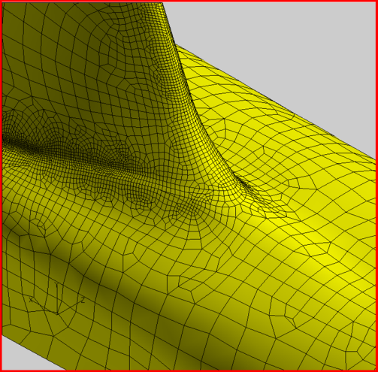
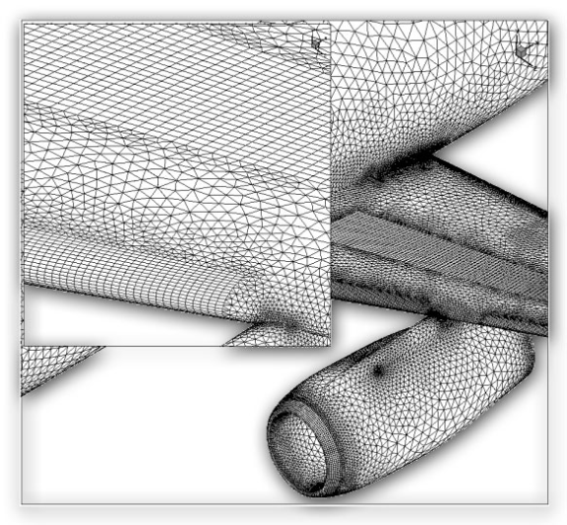
Motivation
Searching some search spaces with traditional search methods would be intractable. This is often true when states/candidate solutions have a large number of successors.
  Example: Designing the surface of an aircraft.
Image source: http://www.centaursoft.com/cms/index.php?section=25
Notes:
Images from http://www.centaursoft.com/cms/index.php?section=25

Slide 4
Applicable situations
Often used for optimization (scheduling, design, etc.) problems, though can be used for many other things as well, as we’ll see a bit later.
  Good problem for GA: Scheduling air traffic
  Bad problems for GA: Finding large primes (why?)
Notes:
Finding large primes is a bad problem for GA because the fitness landscape is not continuous – hard to differentiate between something 1 bit away from a prime, and something that is the complement of a prime.

Slide 5
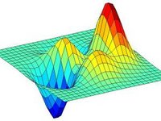
Applicable situations
Genetic algorithms work best when the “fitness landscape” is continuous (in some dimensions). This is also true of standard search, e.g. A*.
  Intuitively, this just means that we can find a heuristic that gives a rough idea of how close a candidate is to being a solution.
Image source: scholarpedia.org

Slide 6
So what is a genetic algorithm?
Genetic algorithms are a randomized heuristic search strategy.
Basic idea: Simulate natural selection, where the population is composed of candidate solutions.
Focus is on evolving a population from which strong and diverse candidates can emerge via mutation and crossover (mating).

Slide 7
Basic algorithm
Create an initial population, either random or “blank”.
While the best candidate so far is not a solution:
  Create new population using successor functions.
  Evaluate the fitness of each candidate in the population.
Return the best candidate found.

Slide 8
Simple example – alternating string
Let’s try to evolve a length 4 alternating string
Initial population: C1=1000, C2=0011
We roll the dice and end up creating C1’ = cross (C1, C2) = 1011 and C2’ = cross (C1, C1) = 1000.
We mutate C1’ and the fourth bit flips, giving 1010. We mutate C2’ and get 1001.
We run our solution test on each. If C1’ is a solution, so we return it and are done.

Slide 9
Basic components
Candidate representation
  Important to choose this well. More work here means less work on the successor functions.
Successor function(s)
  Mutation, crossover
Fitness function
Solution test
Some parameters
  Population size
  Generation limit

Slide 10
Candidate representation
We want to encode candidates in a way that makes mutation and crossover easy.
The typical candidate representation is a binary string. This string can be thought of as the genetic code of a candidate – thus the term “genetic algorithm”!
  Other representations are possible, but they make crossover and mutation harder.

Slide 11
Candidate representation example
Let’s say we want to represent a rule for classifying bikes as mountain bikes or hybrid, based on these attributes*:
  Make (Bridgestone, Cannondale, Nishiki, or Gary Fisher)
  Tire type (knobby, treads)
  Handlebar type (straight, curved)
  Water bottle holder (Boolean)
We can encode a rule as a binary string, where each bit represents whether a value is accepted.
Make Tires Handlebars Water bottle
B
C
N
G
K
T
S
C
Y
N
*Bikes scheme used with permission from Mark Maloof.

Slide 12
Candidate representation example
The candidate will be a bit string of length 10, because we have 10 possible attribute values.
Let’s say we want a rule that will match any bike that is made by Bridgestone or Cannondale, has treaded tires, and has straight handlebars. This rule could be represented as 1100011011:
Make Tires Handlebars Water bottle
1
1
0
0
0
1
1
0
1
1
B
C
N
G
K
T
S
C
Y
N

Slide 13
Successor functions
Mutation – Given a candidate, return a slightly different candidate.
Crossover – Given two candidates, produce one that has elements of each.
We don’t always generate a successor for each candidate. Rather, we generate a successor population based on the candidates in the current population, weighted by fitness.

Slide 14
Successor functions
If your candidate representation is just a binary string, then these are easy:
  Mutate(c): Copy c as c’. For each bit b in c’, flip b with probability p. Return c’.
  Cross (c1, c2): Create a candidate c such that c[i] = c1[i] if i % 2 = 0, c[i] = c2[i] otherwise. Return c.
    Alternatively, any other scheme such that c gets roughly equal information from c1 and c2.

Slide 15
Fitness function
The fitness function is analogous to a heuristic that estimates how close a candidate is to being a solution.
In general, the fitness function should be consistent for better performance.
However, even if it is, there are no guarantees. This is a probabilistic algorithm!

Slide 16
Solution test
Given a candidate, return whether the candidate is a solution.
Often just answers the question “does the candidate satisfy some set of constraints?”
Optional! Sometimes you just want to do the best you can in a given number of generations.

Slide 17
New population generation
How do we come up with a new population?
  Given a population P, generate P’ by performing crossover |P| times, each time selecting candidates with probability proportional to their fitness.
  Get P’’ by mutating each candidate in P’.
  Return P’’.
Notes:
Mutation is necessary because some important gene might be missing from all of the initial population.

Slide 18
Basic algorithm (recap)
Create an initial population, either random or “blank”.
While the best candidate so far is not a solution:
  Create new population using successor functions.
  Evaluate the fitness of each candidate in the population.
Return the best candidate found.

Slide 19

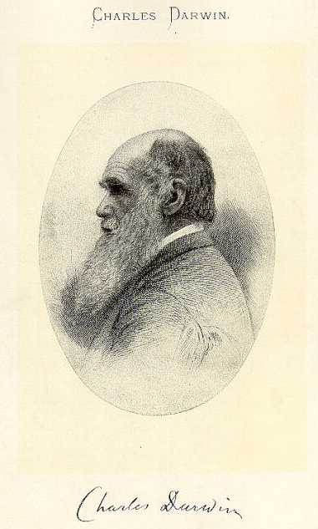
Knapsack Problem
Problem Description:
You are going on a picnic.
And have a number of items that you could take along.
Each item has a weight and a benefit or value.
You can take one of each item at most.
There is a capacity limit on the weight you can carry.
You should carry items with max. values.

Slide 20
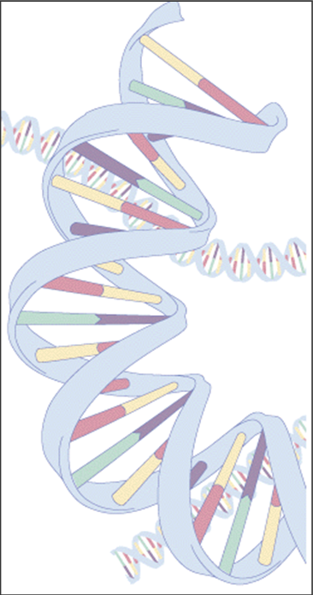

Knapsack Problem
Example:
Item: 1 2 3 4 5 6 7
Benefit: 5 8 3 2 7 9 4
Weight: 7 8 4 10 4 6 4
Knapsack holds a maximum of 22 pounds
Fill it to get the maximum benefit

Slide 21

Genetic Algorithm
Outline of the Basic Genetic Algoritm
[Start]
  Encoding: represent the individual.
  Generate random population of n chromosomes (suitable solutions for the problem).
[Fitness] Evaluate the fitness of each chromosome.
[New population] repeating following steps until the new population is complete.
[Selection] Select the best two parents.
[Crossover] cross over the parents to form a new offspring (children).

Slide 22
Genetic Algorithm
Outline of the Basic Genetic Algoritm Cont.
[Mutation] With a mutation probability.
[Accepting] Place new offspring in a new population.
[Replace] Use new generated population for a further run of algorithm.
[Test] If the end condition is satisfied, then stop.
[Loop] Go to step 2 .

Slide 23
Basic Steps
Start
Encoding: 0 = not exist, 1 = exist in the Knapsack
  Chromosome: 1010110
  => Items taken: 1, 3 , 5, 6.
Generate random population of n chromosomes:
  0101010
  1100100
  0100011
Item. | 1 | 2 | 3 | 4 | 5 | 6 | 7
Chro | 1 | 0 | 1 | 0 | 1 | 1 | 0
Exist? | y | n | y | n | y | y | n

Slide 24
Basic Steps Cont.
Fitness & Selection
✗
0101010: Benefit= 19, Weight= 24
1100100: Benefit= 20, Weight= 19.
0100011: Benefit= 21, Weight= 18.
Item | 1 | 2 | 3 | 4 | 5 | 6 | 7
Chro | 0 | 1 | 0 | 1 | 0 | 1 | 0
Benefit | 5 | 8 | 3 | 2 | 7 | 9 | 4
Weight | 7 | 8 | 4 | 10 | 4 | 6 | 4
✓
✓
=> We select Chromosomes b & c.

Slide 25
Basic Steps Cont.
Crossover & Mutation
Parent 1
1 1 0 0 1 0 0
Parent 2
0 1 0 0 0 1 1
Child 1
1 1 0 0 0 1 1
Child 2
0 1 0 0 1 0 1
Mutation
0 1 0 0 1 0 0

Slide 26
Basic Steps Cont.
Accepting, Replacing & Testing
Place new offspring in a new population.
Use new generated population for a further run of algorithm.
If the end condition is satisfied, then stop. End conditions:
  Number of populations.
  Improvement of the best solution.
Else, return to step 2 [Fitness].

Slide 27
Genetic Algorithm
Conclusion
GA is nondeterministic – two runs may end with different results
There’s no indication whether best individual is optimal

Slide 28
Pros and Cons
Pros
  Faster (and lower memory requirements) than searching a very large search space.
  Easy, in that if your candidate representation and fitness function are correct, a solution can be found without any explicit analytical work.
Cons
  Randomized – not optimal or even complete.
  Can get stuck on local maxima, though crossover can help mitigate this.
  It can be hard to work out how best to represent a candidate as a bit string (or otherwise).

